Slide 1
A Comprehensive Exploratory and Predictive Analysis of Factors Impacting Graduation and Drop Out Rate in College

Slide 2
Introduction
This report conducts a thorough analysis of factors impacting student success, focusing on graduation and dropout rates and serves as a guide for informed decision-making and impactful interventions in the educational landscape.
The goal is to inform strategic planning for targeted improvements, fostering increased enrollment, higher graduation rates, and reduced dropout occurrences.

Slide 3
Problem Statement
Higher education institutions aim to prepare students for successful careers and contribute highly qualified professionals to society.
However, challenges exist, with only 33.7% of individuals aged 25 and above in the U.S. holding a bachelor's degree or higher (US Census Bureau, 2022).
Student dropout rates, a significant issue, impact over half of enrolled students (Kantrowitz, 2021).
Timely intervention for at-risk students and the use of machine learning models can enhance success.

Slide 4
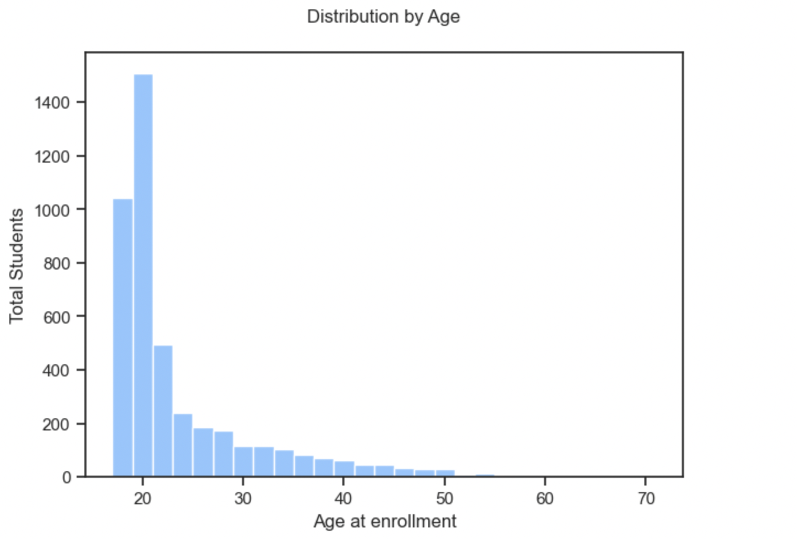
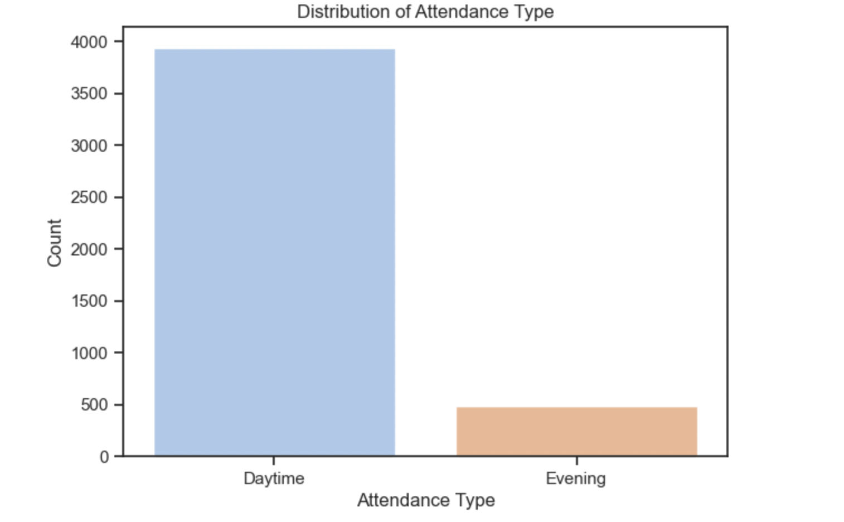
Exploratory Analysis: The Current State and Trends of Students
Most students in the sample population are between the ages of 18-21, consistent with what we would expect with undergraduate enrollment.
There are more students that attend classes in the day relative to the evening. This is expected as well.

Slide 5
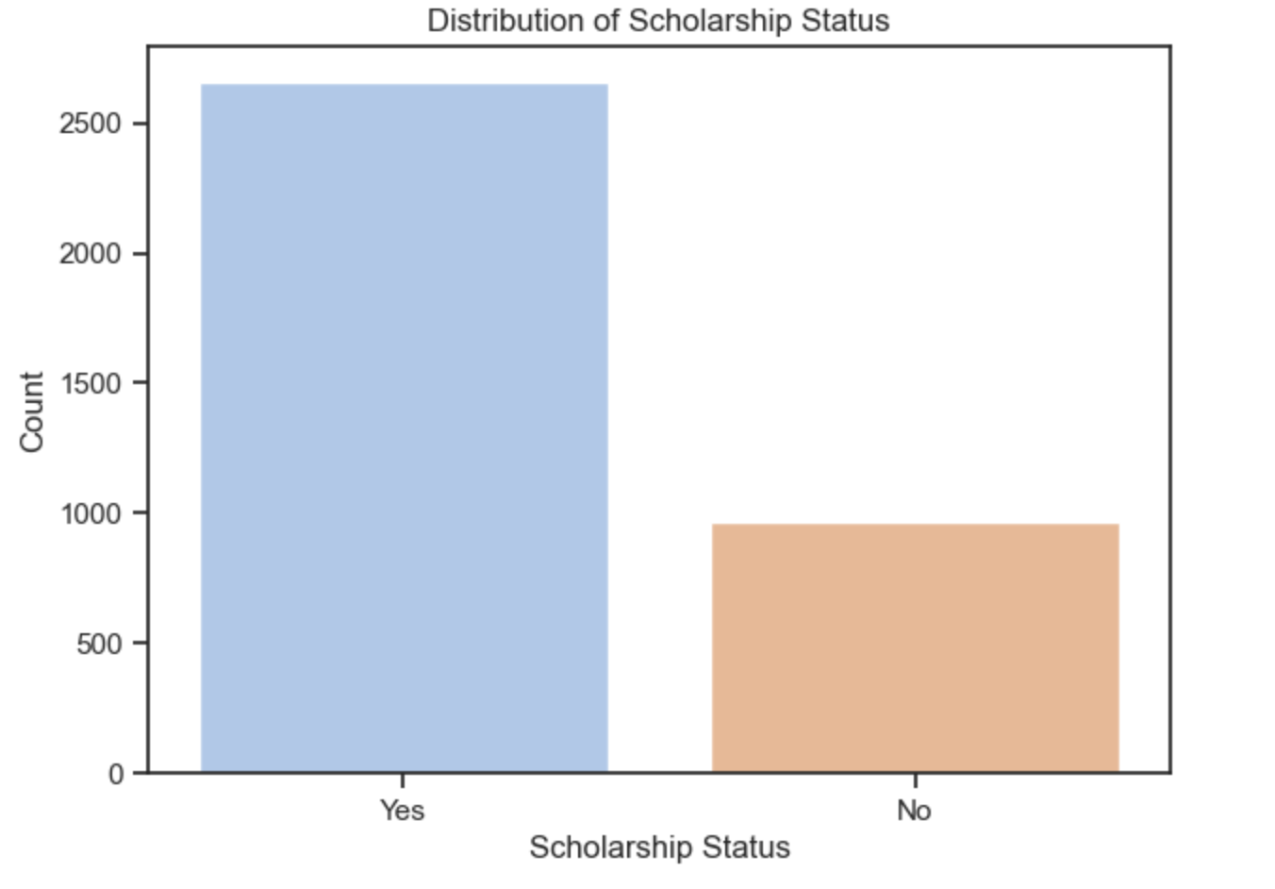
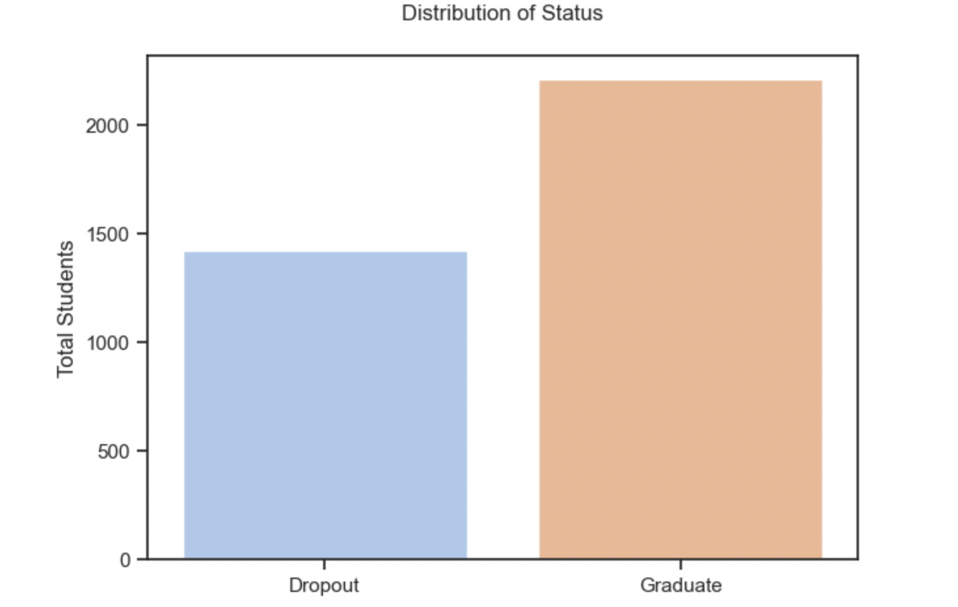
Exploratory Analysis Cont’d
From the above, it can be noticed that most student have some scholarships. Precisely, about 71% students have some scholarship against 29% of students with no scholarships.
Regarding status of student in terms of graduation and drop out, there are more students that graduate compared to drop out. However, the drop out rate of about 27% is high.

Slide 6
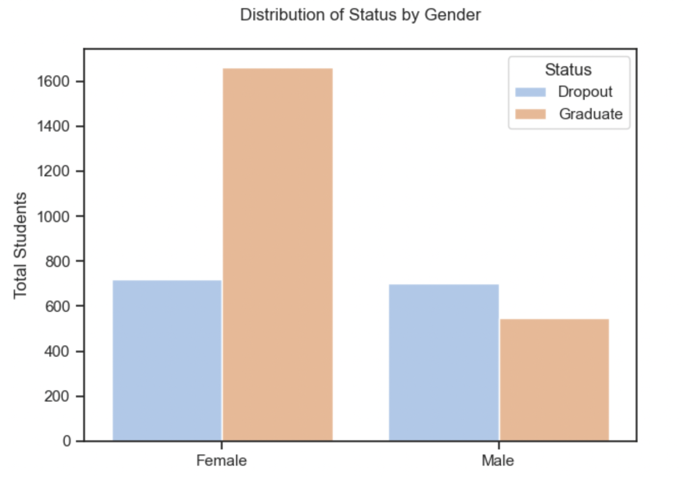
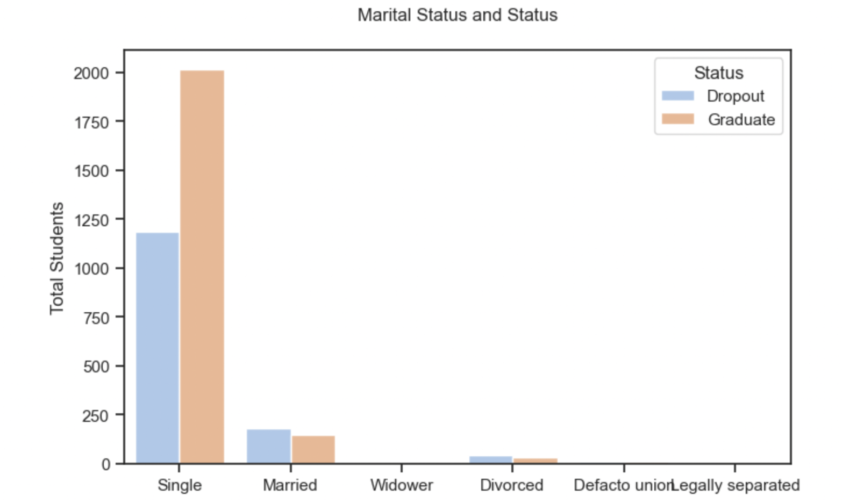
Diagnostic Analysis: Factors that may contribute to the current state and trends
Demographic Analysis
Aside from there being more female than male students, the drop out among male students is higher relative to female students. However, it is fairly the same among genders.
There are more students that are single in terms of marital status. Moreover, the drop out rate for married students is high relative to graduation unlike single students.
Notes:
NOTE: The use of 'male' and 'female' as gender categories is solely based on the available data and not intended to imply any bias. The dataset may lack representation of non-binary or other gender identities. We acknowledge this limitation in our data collection.

Slide 7
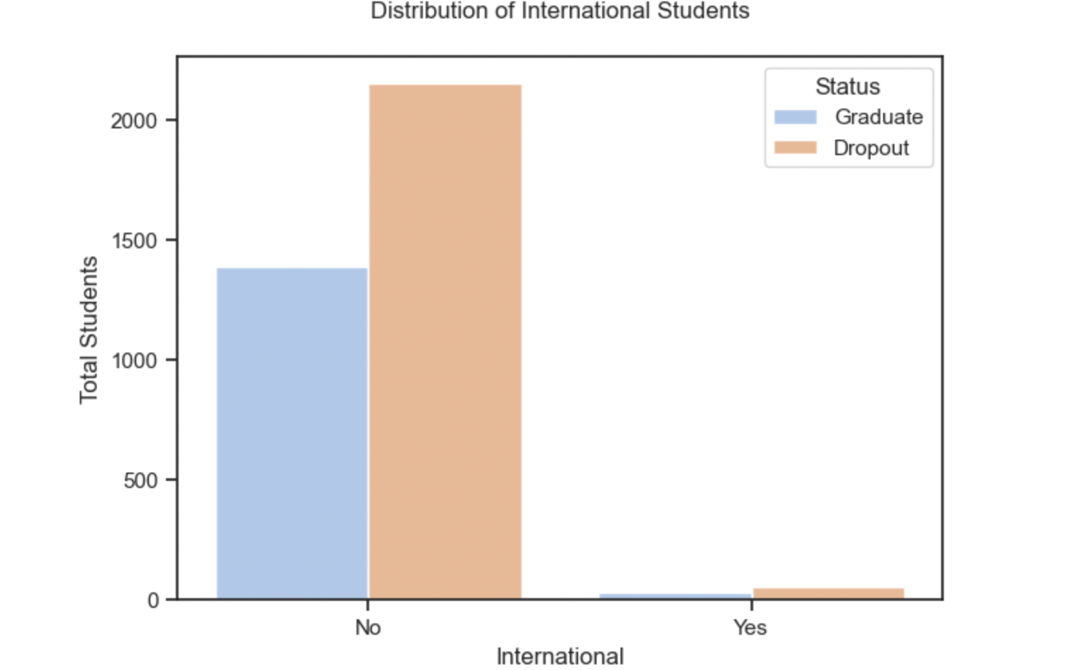
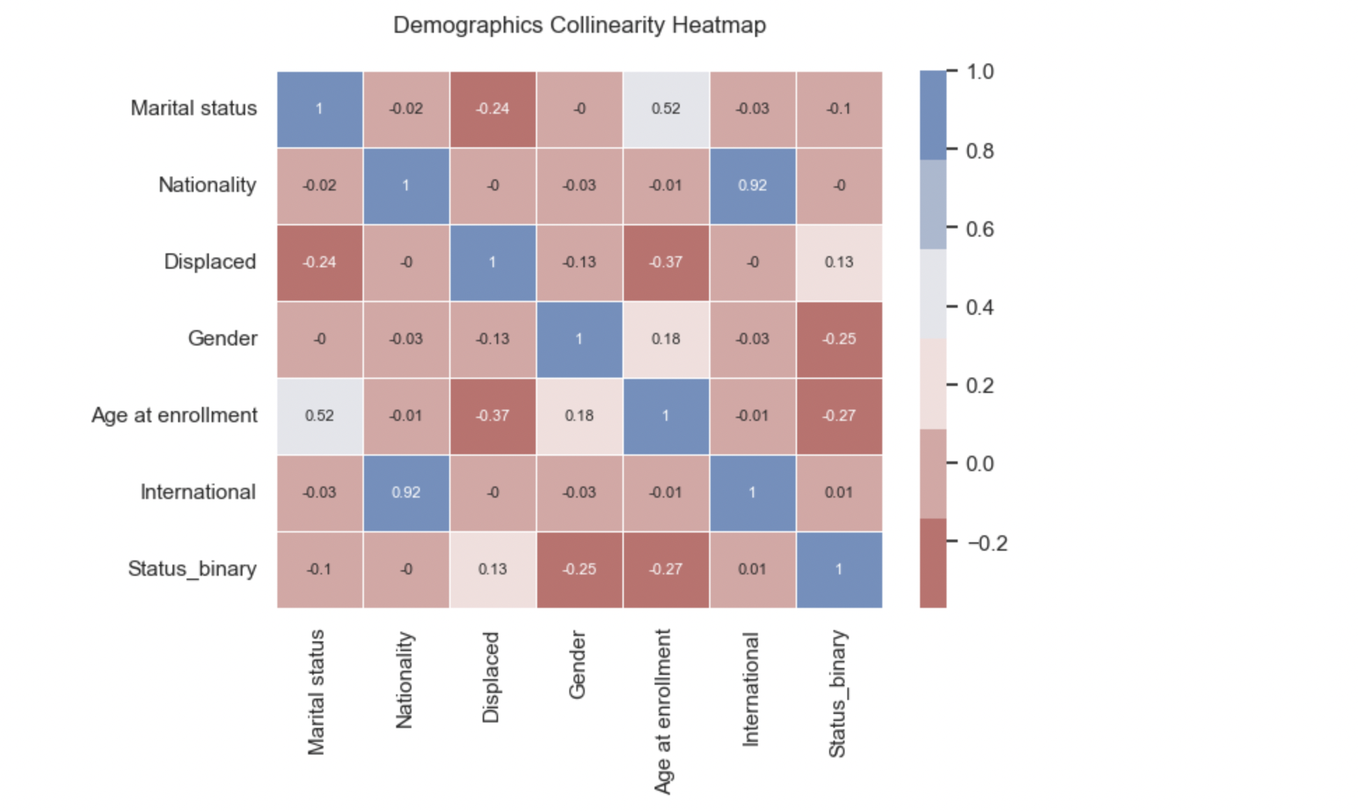
Demographic Analysis Cont’d
From the distribution, most of the students are nationals of the country and few are international students. Also, graduation rate is higher relative to drop out rate for both international and non international students.
The above shows that gender and age at enrollment have the highest correlation with whether a student graduates or drop out. The negative correlation implies that male student and students with higher age at enrollment are more likely to drop out.

Slide 8
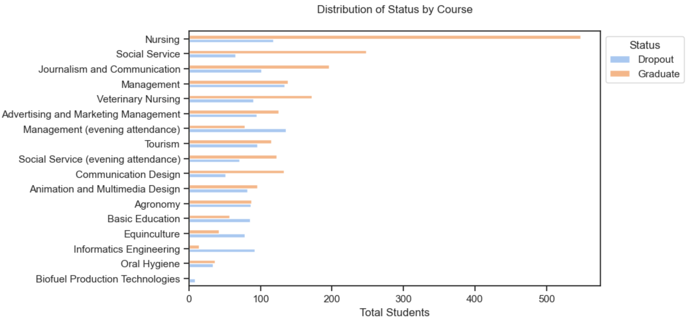
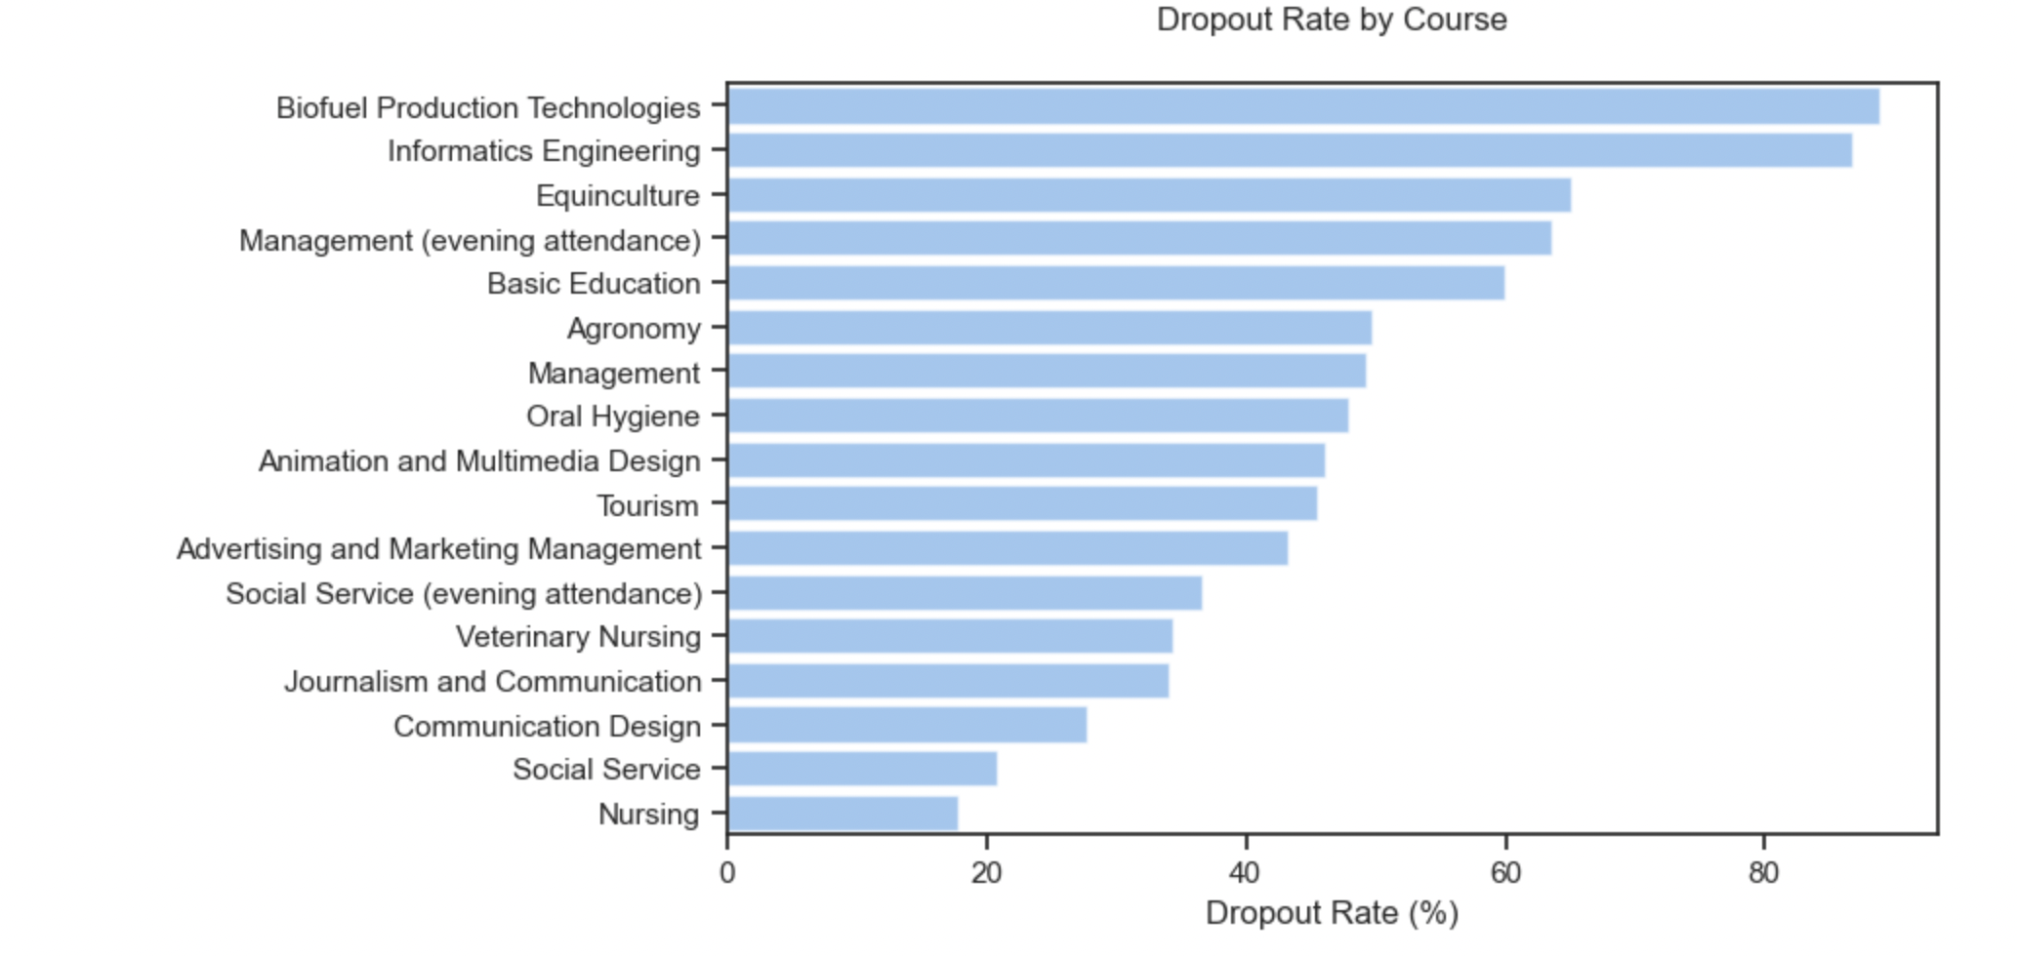
Academic Analysis
Nursing has the lowest drop out rate and Biofuel Production Technology has the most. There are some interesting insights that may indicate some courses are more challenging for students to complete than others. 7 out of 17 courses have over 50% dropout rate.
It can be seen that for most of the course programs, students graduate than drop out aside from Management (evening attendance), Basic Education, Equinculture, and Informatics Engineering.

Slide 9
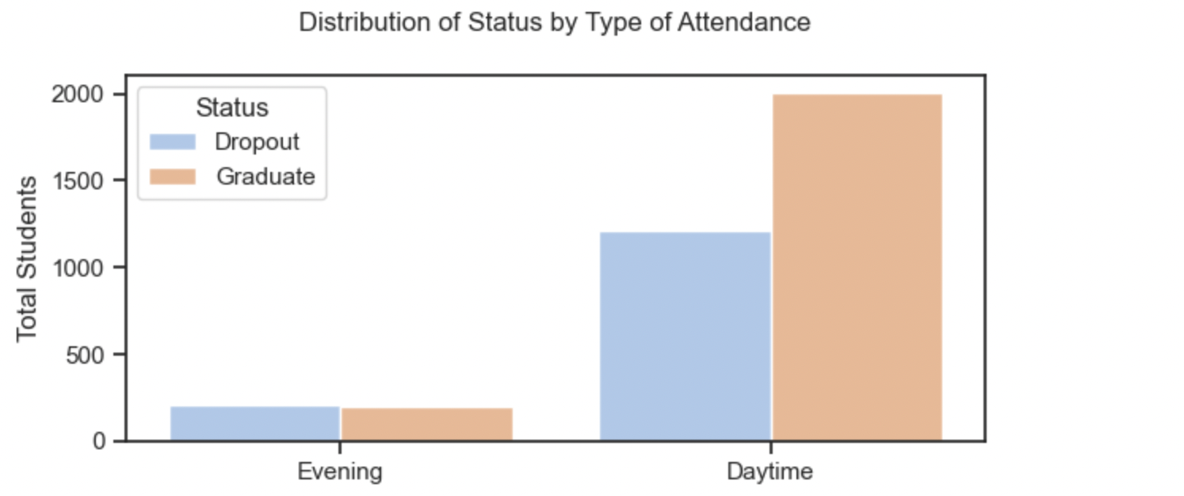
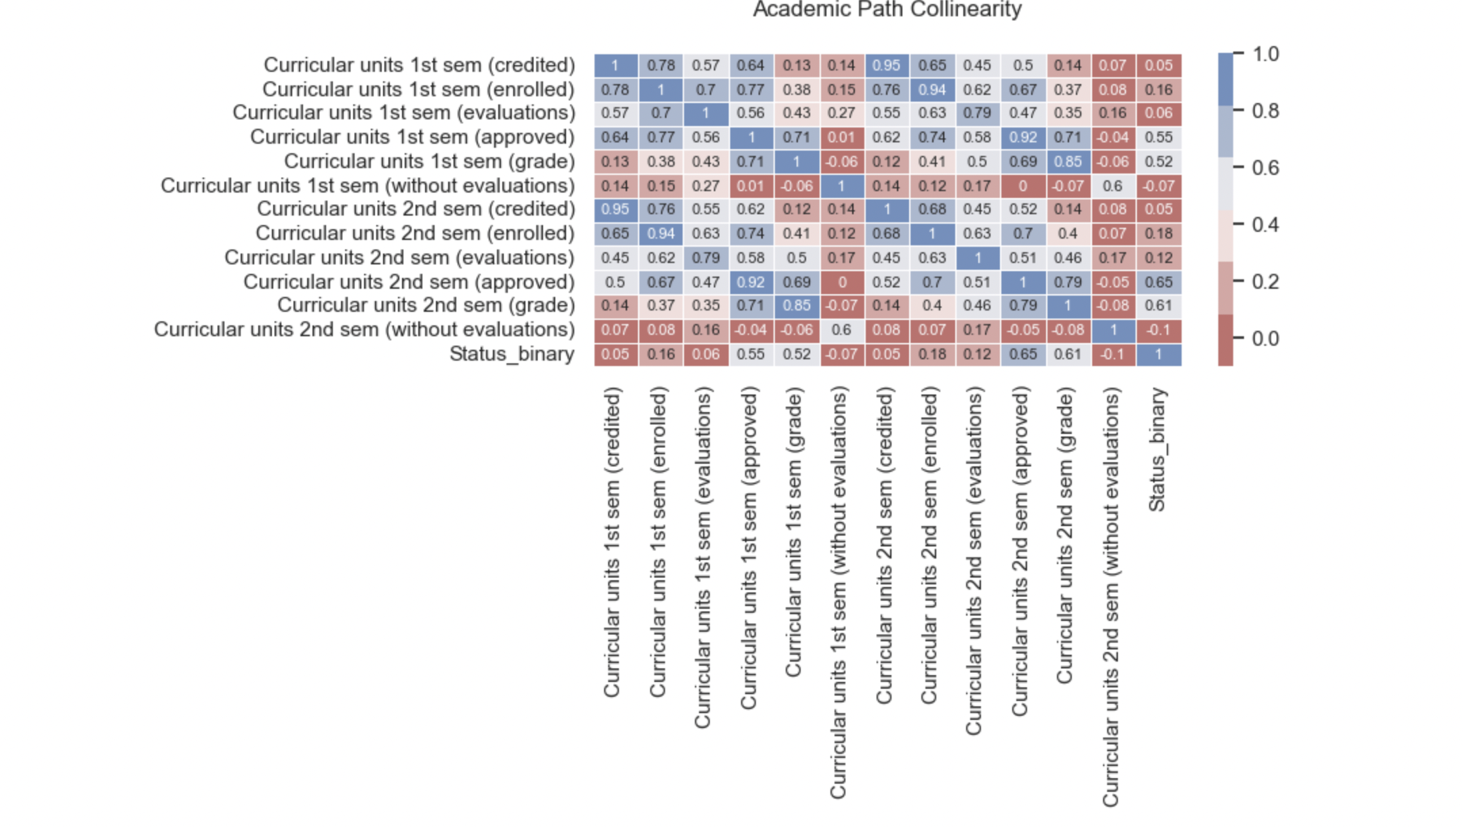
Academic Analysis Cont’d
Academic Analysis Cont’d
It can be observed that students who attend classes in the daytime have a lower drop out rate compared the evening students. However, the rates of drop out for both type of attendance is high.
In terms of academics, second semester grade has the highest correlation with whether a student drop out or graduates.

Slide 10
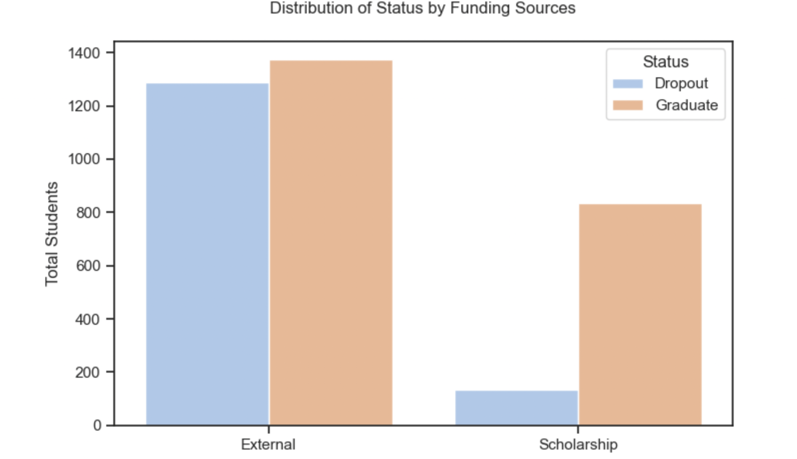
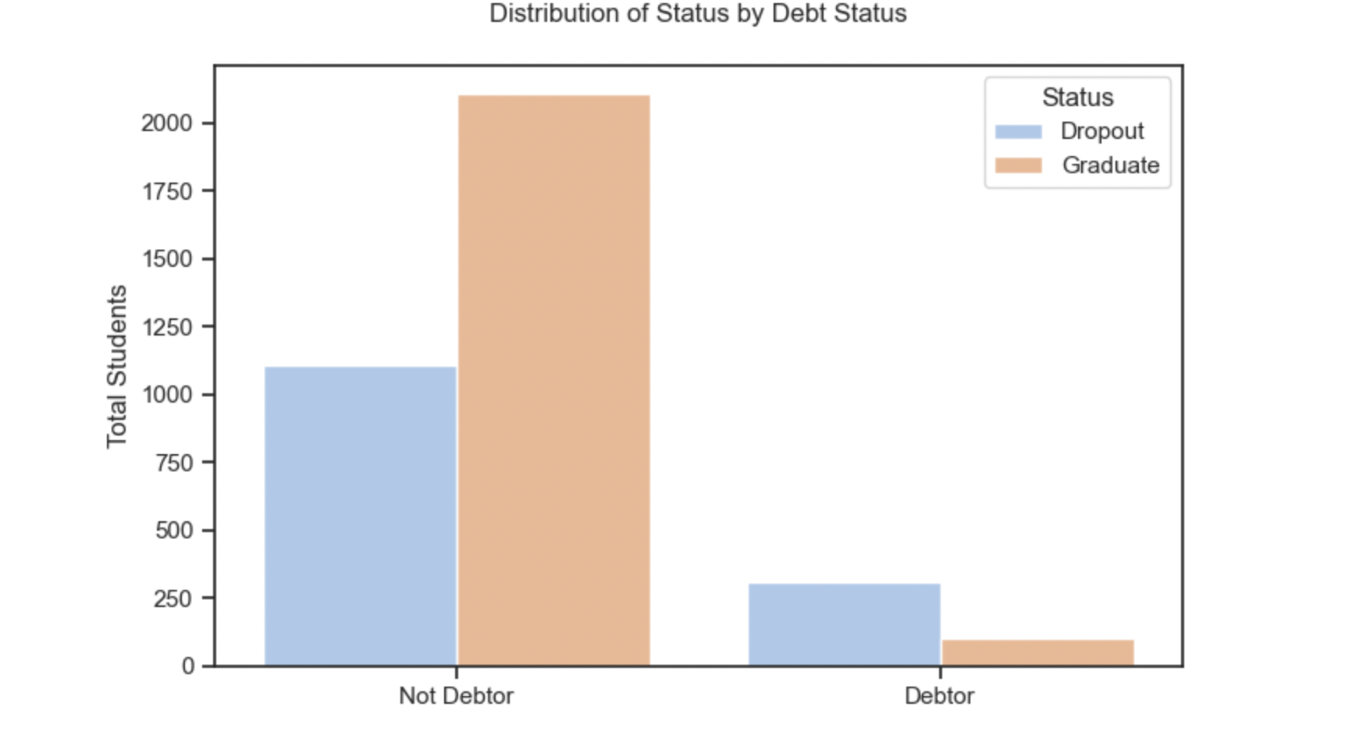
Funding Analysis
It can observed that students with scholarships have lower drop out rate relative to students with external funding.
The above visualization show that students who are in debt have higher drop out rate relative to students who do not have debt.

Slide 11
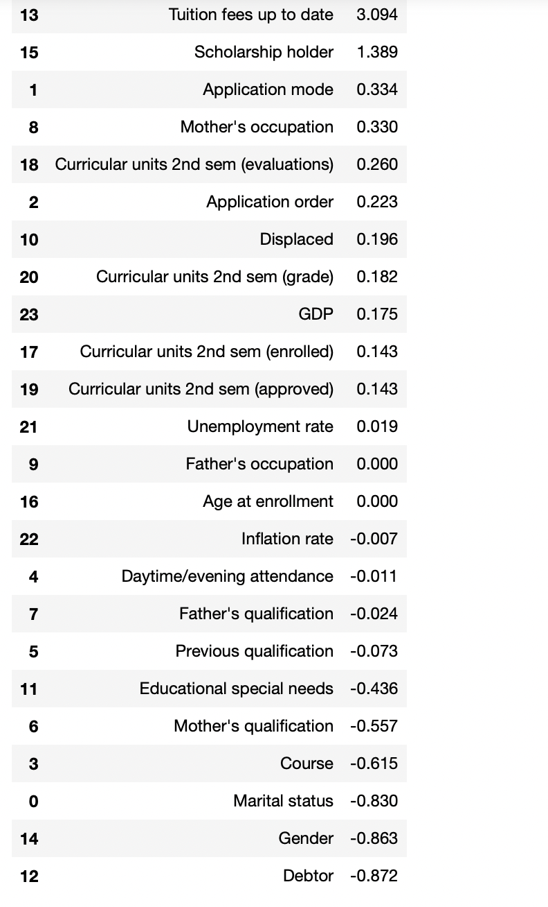
Predictive Analysis: Forecasting Student Success
A logistic model was fitted to predict student’s success in terms or whether they will graduate or drop.
The coefficient on the left shows the magnitude of impact that the variables employed have on whether or not a student graduate.
Students with debt, married, and male have a lower odds of graduating.
Students with paid tuition, scholarship holders have a higher odds of graduating.

Slide 12
Insights and Recommendations
Findings and Insights
Most of the students are between the ages of 18 and 21 and attend class during the day.
71% of students against 29% have scholarships.
Graduation rate is higher than drop out rate. However, the drop out rate of about 27% is significantly high.
The drop out rate for males is relatively higher than that of females.
Married students drop out more than single students.
Gender and age of enrollment has the highest and negative correlation with whether or not a student graduates or drop out.
Nursing has the lowest drop out rate and Biofuel Production Technology has the most.
7 out of 17 courses have over 50% dropout rate.
Students with debt, married, and male have a lower odds of graduating.
Students with paid tuition, scholarship holders have a higher odds of graduating
Recommendations
Consider tailoring class schedules and academic support services to accommodate the peak age range of 18 to 21, especially for daytime classes.
Promote and expand scholarship programs, as well as explore options for reducing financial burdens on students
Develop gender-inclusive support services that address the needs and challenges faced by both male and female students, ensuring equitable access to resources and assistance.
Develop support programs or counseling services tailored for married students to assist them in overcoming challenges that may lead to a higher dropout rate.
Encourage and promote extracurricular activities to enhance student engagement and connection to the college community. This can positively impact overall student satisfaction and retention
Establish a system for regular reviews of dropout data to identify emerging trends or shifts in dropout patterns. This proactive approach allows for timely interventions and adjustments to support strategies.

Slide 13
Conclusion
In summary, the analysis highlights critical factors influencing student success. While a majority of students are aged 18 to 21 attending daytime classes, financial disparities, especially the 29% without scholarships, call for attention.
Although the overall graduation rate exceeds dropouts, the significant 27% dropout rate, notably higher for males and married students, prompts targeted interventions. Gender and age at enrollment play pivotal roles, necessitating tailored support.
Course-specific insights indicate the need for individualized strategies, especially in high dropout courses like Biofuel Production Technology. Recommendations include tailored class schedules, expanded scholarships, gender-inclusive support, and proactive measures such as regular dropout data reviews.
Moving forward, integrating these strategies into our support framework will create a more inclusive and successful educational journey for all students.

